Slide 1


Bank of Baroda Hackathon - 2022
Technology Partner
Easy Verify
Date : 16/09/22

Slide 2
Problem Statement?
Bank handles large volumes of cheques in the clearing process. The process involves many technical verifications including signature verification. Some of these steps are manual and require human intervention to complete the process. The current process requires the high human capital deployment and longer processing time.

Slide 3
User Segment & Pain Points
Our Application is for the customers using bank service (cheque , transaction , saving deposits , etc) and the one’s searching for easy banking methods.
Our application will reduce time of these processes .
It will require less human efforts .
It can save the bank and user from fraud .
The application will support Multilingual , so it will be more user friendly .
Will be able to do Automatic Data Entry, Signature Verification & Technical verification .
Will use a voice assistant to interact with user’s and will give them solutions of their problems and some helpful suggestions .
User will be able to give there feedback at the end of the process , every time they use the application .

Slide 4
Pre-Requisite
There are several alternatives/competitive products for the problem we are solving
Banking applications in India like HDFC mobile app , YONO SBI , ICICI iMobile App , Axis Mobile App , Kotak-811 & Mobile App , IDBI GO Mobile + App , PNB ONE Mobile App , Bank of Baroda M- Connect Plus App, are already being used by a huge number of users today .

Slide 5
Azure tools or resources
1. Azure Cognative Service 2. Azure Computer Vision 3. Software developer tools for python

Slide 6
METHODOLOGY
Voice Assistant / Chatbot
Face Recognition
Cheque / Document Verification/ fraud detection
Easy Verify
Sensors
Object Detection
Data Analysis
Voice Reader

Slide 7
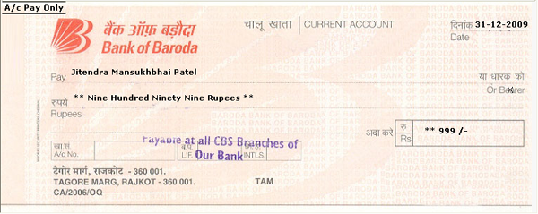



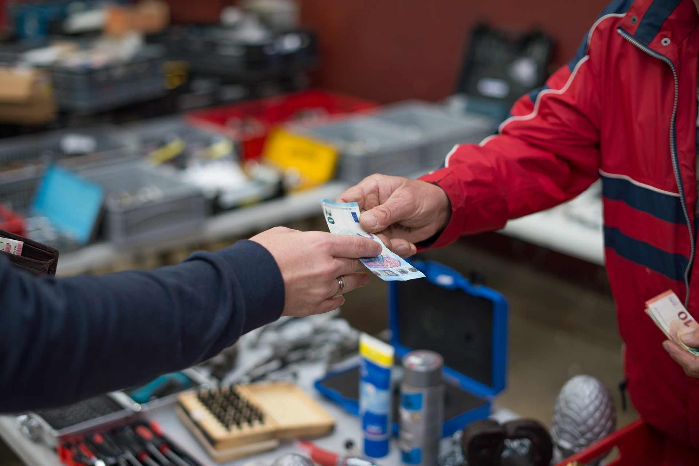

METHODOLOGY
This Photo by Unknown Author is licensed under CC BY-SA-NC

Slide 8
Key Differentiators
Our Solution offers Voice assistant feature that makes it easier for user to operate , also it multilingual ,and thus can help a lot of users from different – different language backgrounds .
It has a special feature of Fraud dectection that protects both the bank and the user .

Slide 9
Adoption Plan
Easy to understand and use
Our product is easy to use as it can interact with user through voice .As we know a lot of users struggle a lot in understanding the app or software , our product offers them with a voice assistant that can resolve their issues smartly and quickly .
Saves Users time and efforts
It saves users time as all the processes are almost automatic and they will have to give very less efforts and time .
Data Security
Since we are providing with a fraud detection feature users data is much more safe .
Users feedback
Every time the user use the application it will ask for a feedback , so that the problems of user can be solved quickly . And they can have a much better experience next time .

Slide 10
Thank You
Member Details :
Sunisha Singh (Smart Manufacturing)
Abhinav Gautam (Mechanical )
(4yr, B.Tech ,Indian Institute of Information Technology Design and Manufacturing Jabalpur)

